Slide 1
Week 10
GOOD bye AND GOOD LUCK!

Slide 2
Student Objectives
Upon completion of this video, you should be able to:
Laugh at 3 of my favourite cartoons about databases

Slide 3

Do NOT Name your kid: Robert’); drop table Student;

Slide 4
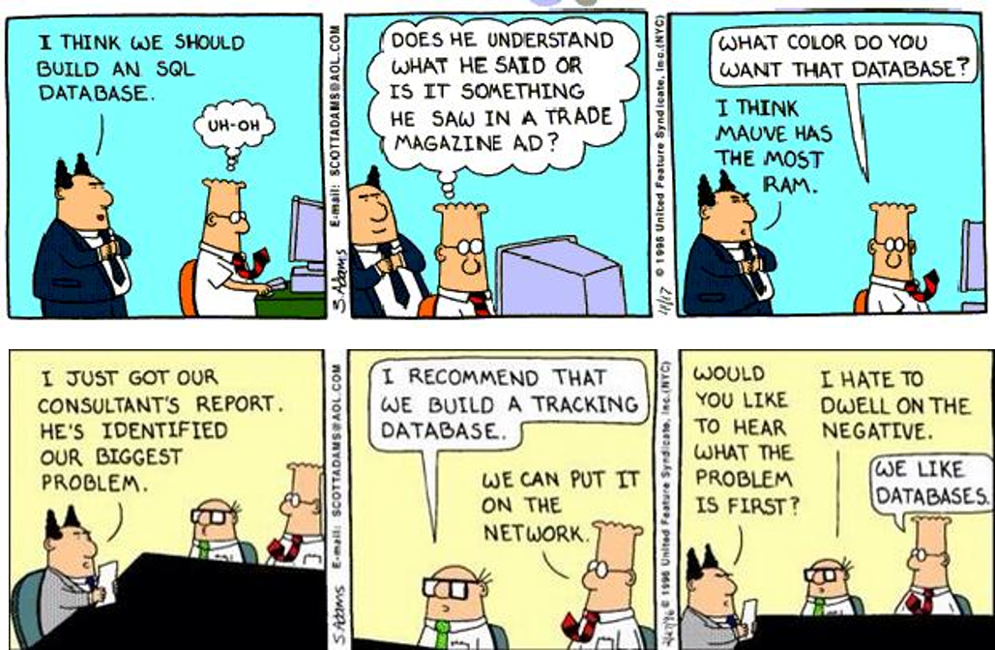

Slide 6
Good Luck on Your Exams!

